Slide 1
Bangla Handwritten OCR: A Hybrid Deep Learning Approach
Bangladesh University of Engineering and Technology
Department of Electrical and Electronic Engineering
EEE 400 (June 2024) - Final Examination
Presentation Date: 24th June, 2024
Presented by:
Sumaiya Salekin Student ID: 1806191
Aye Thein Maung Student ID: 1806195
Examination Committee:
Dr. Mohammad Ariful Haque (Supervisor)
2. Dr. Mohammed Imamul Hassan Bhuiyan
(Member)
3. Dr. Hafiz Imtiaz
(Member)

Slide 2
Outline of Presentation
Introduction
Acknowledgement and References
Literature Review
Data Pre-processing and Training
Results
Methodology
Conclusion

Slide 3
Outline of Presentation
Introduction
Acknowledgement and References
Literature Review
Data Pre-processing and Training
Results
Methodology
Conclusion

Slide 4
Introduction
Motivation
OCR stands for Optical Character Recognition technology that recognizes text within a digital image.
Practical Applications:
Document digitization
- Automated data entry
- Text extraction
- License plate recognition
Translation services
Archiving historical documents

Slide 5
Introduction
Motivation
Though there are numerous advancements in OCR techniques, it is still challenging for languages like Bangla with a complex writing system.
This is due to-
The complex character set of Bangla alphabets.
Scarcity of large annotated datasets for Bangla.
Variations in the writing style between individuals.

Slide 6
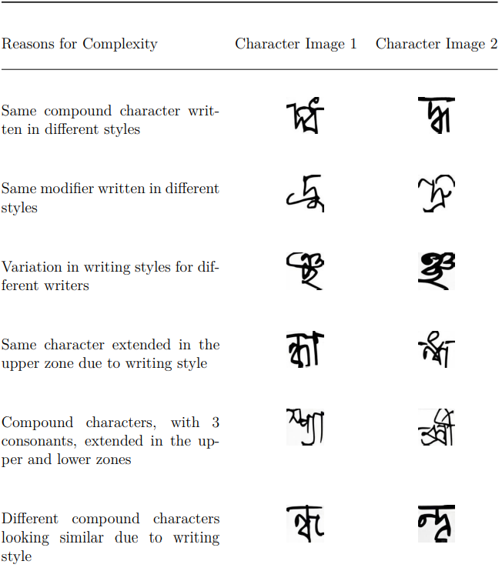
Introduction
Character
Complexities

Slide 7
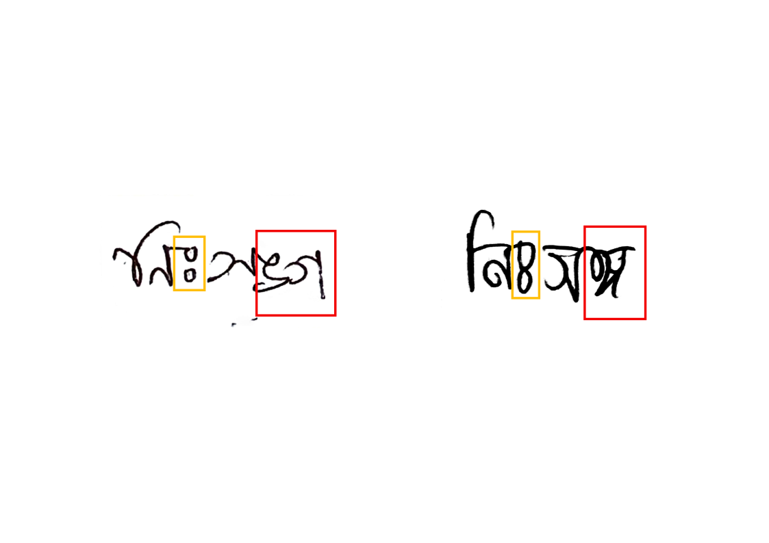
Introduction
Different written forms of the same word “নিঃসঙ্গ” written by two different writers

Slide 8
Introduction
Objective
Our objective is to combat these difficulties, through a Hybrid OCR approach that breaks down the challenge into two parts: character isolation and recognition.
We propose a pipeline that takes advantage of the already existing state of the art models to enhance Bangla OCR capabilities.

Slide 9
Outline of Presentation
Introduction
Acknowledgement and References
Literature Review
Data Pre-processing and Training
Results
Methodology
Conclusion

Slide 10
Literature Review
Classification of OCR Techniques
Two Broad Classes:
Feature Extraction Method
Segmentation Method
Different Classifiers are used with these methods to get the highest accuracy.

Slide 11
Literature Review
Feature Extraction Method
Hand-crafted Features
Transform-based Features
Machine learning Features
Deep-learning Features

Slide 12
Literature Review
Hand Crafted Features
Structural Features
Statistical Features
Geometric and Contour

Slide 13
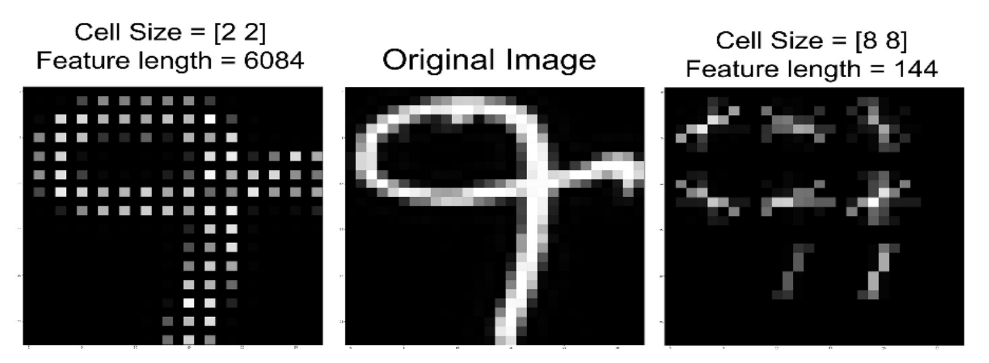
Literature Review
Feature extraction method
Hand Crafted Features
Manually designing algorithms to extract relevant features from input data. Such as, HOG(Histogram of Oriented Gradients), LPB, Gabor filters, etc.
Limitations- handling noisy datasets with varied handwriting
Fig: HOG features of an Ekush image dataset
Wahid et al. (2021)

Slide 14
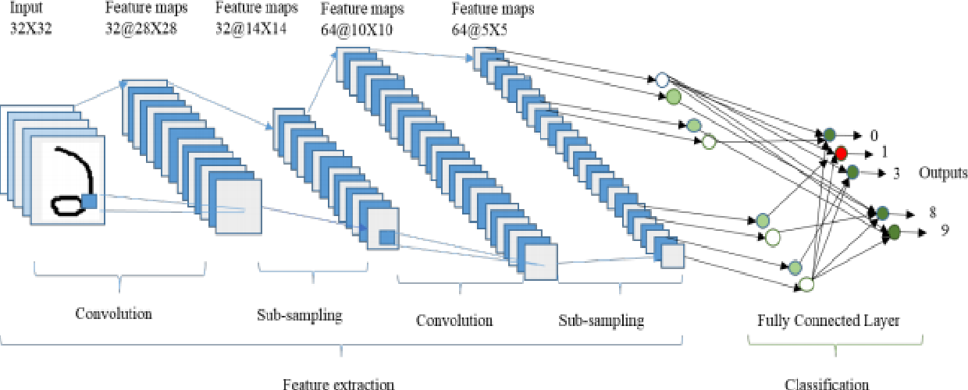
Literature Review
Feature extraction method
Deep Learning Model Features
Automatically learning hierarchical features from raw data. The multiple convolutional and pooling layers learn to detect relevant features, like- edges, textures, etc., making it adaptable to complex patterns and variations.
Limitations- similar shaped characters, cursive writing and variabilities in writing style.
Fig: Basic CNN architecture for recognition
Alom et al. (2018)

Slide 15
Literature Review
Segmentation-based Approach
Traditional Segmentation
Advanced Segmentation

Slide 16
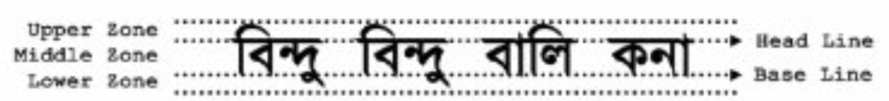
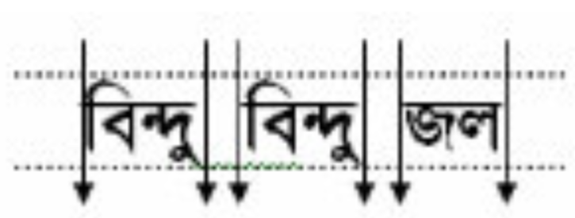
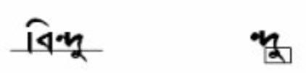

Literature Review
Segmentation-based Approach
Traditional Segmentation
Fig: Zones of Bangla Script
Isolates the character regions from words. For example, labeling connected regions by finding contiguous areas of similar pixel values in CCA (Connected Component Analysis) method.
Limitations- closely spaced characters, character shape distortion, and non-horizontal text lines.
Fig: Word Segmentation
Fig: Extracting characters above matra and below baseline
Mahmud (2017)

Slide 17
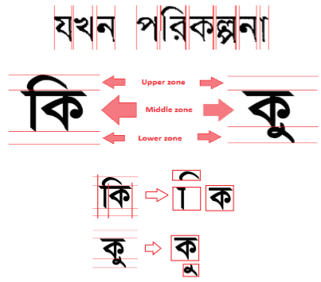
Literature Review
Segmentation-based Approach
Advanced Segmentation
Through the use of neural networks the system learns from segmentation errors and improves over time.
Limitations- overlapping characters, thick matra, training data dependencies, scalability issues, and error propagation.
Fig: Character Segmentation
Ahmed (2014)

Slide 18
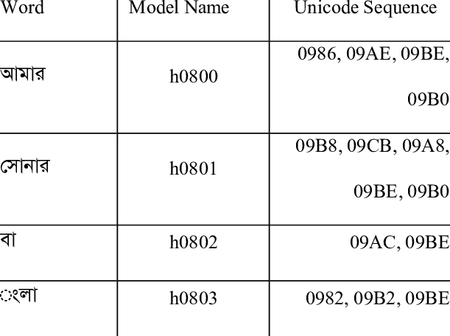
Literature Review
Use of different Classifiers
Traditional Classifiers
Categorize individual character or words into predetermined classes based on extracted features. Identifies using matching against learned patterns, such as, HMM (Hidden Markov Models), KNN, etc.
Limitations- complex characters, high variability, and noise sensitive.
Fig: Word Mappings in a segmentation free OCR using HMM.
Hasnat (2010)

Slide 19
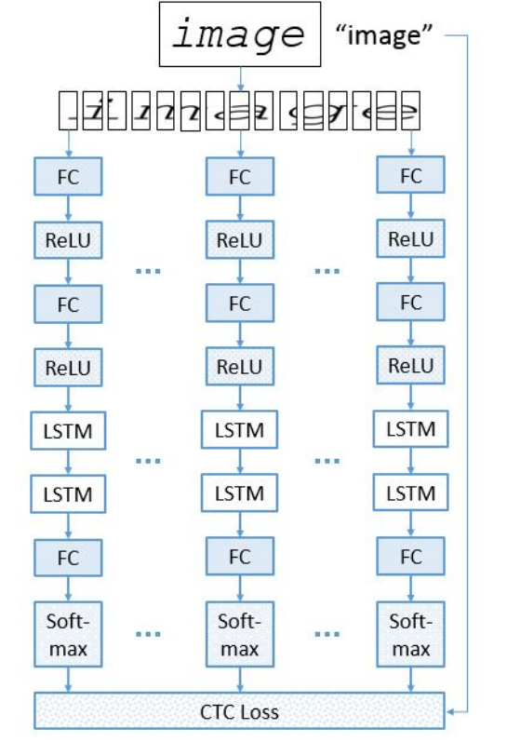
Literature Review
Segmentation-based Approach
Deep Learning Classifiers
Use Artificial Neural Networks(ANNs) to learn and classify complex patterns.
Limitations- data hungry, black-box nature, and risk of overfitting.
Fig: The feature extraction layer takes image frame input and the LSTM layers function as recognition layers.
Sabir et al. (2018)

Slide 20
Outline of Presentation
Introduction
Acknowledgement and References
Literature Review
Data Pre-processing and Training
Results
Methodology
Conclusion

Slide 21
Methodology
Our Proposed pipeline-
Detection-based character isolation using YOLOv8
Feeding the isolated character patches to the recognition-based model, EfficientNet-b4.
A Word2Vec spellchecker model as an optional plug-in for increased accuracy.

Slide 22
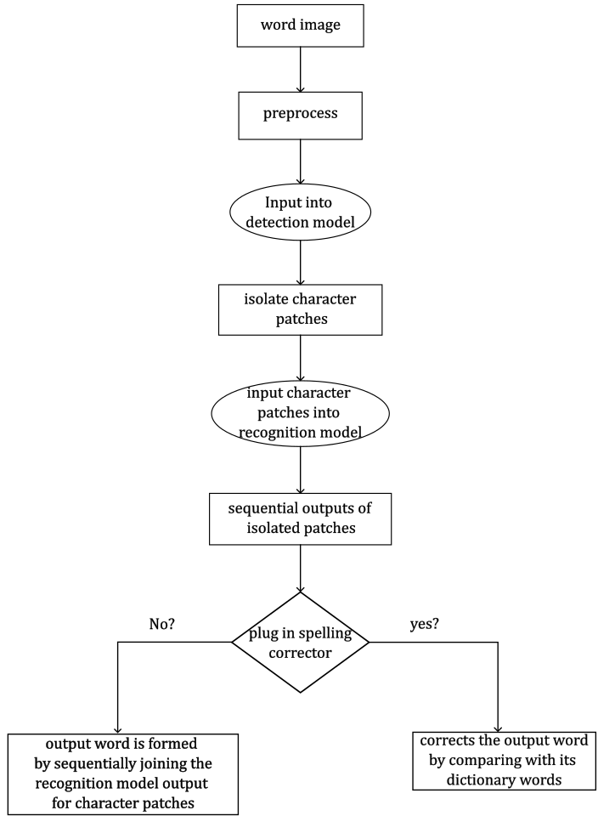
Methodology
Flowchart of Proposed Pipeline

Slide 23
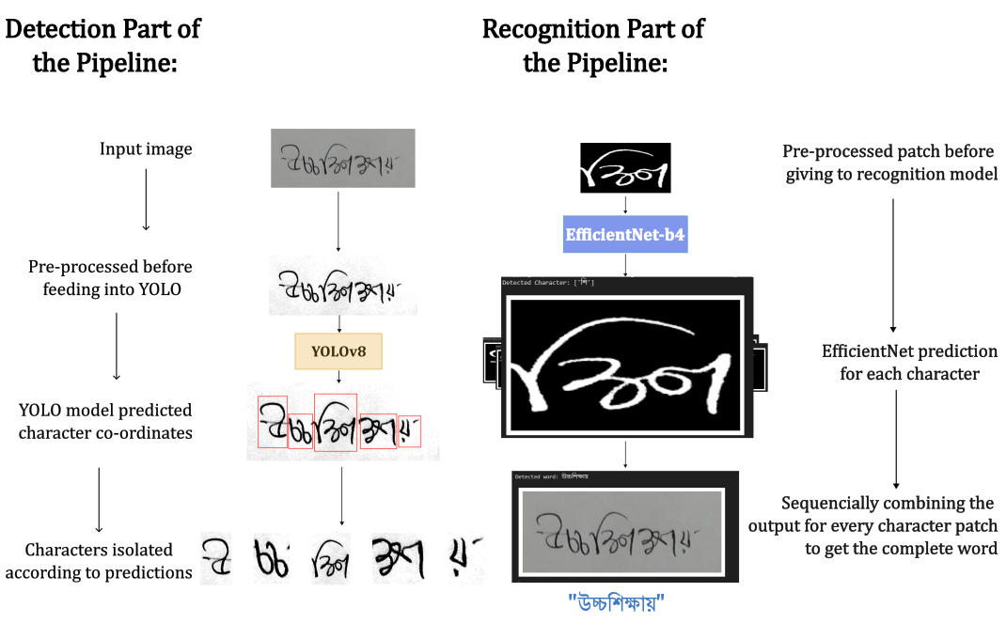
Methodology
Working Example of the Pipeline

Slide 24
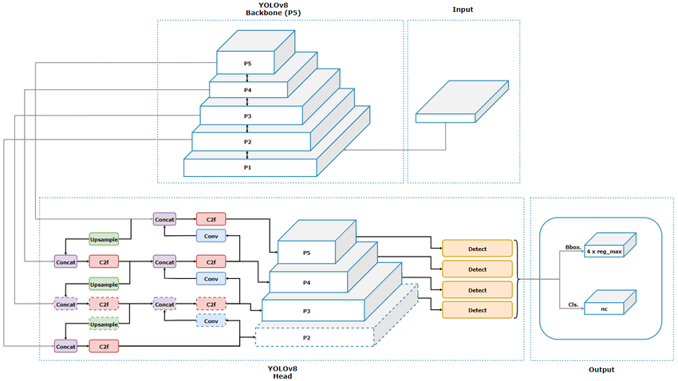
Methodology
Architecture of YOLOv8 model

Slide 25
Methodology
Object detection using YOLOv8 model
Bounding box Predictions:
Prediction components-
Center Coordinates (tx, ty): Relative to the grid cell.
Dimensions (tw, th): Width and height of the bounding box.
Confidence Score (tc): Indicates the likelihood of the bounding box containing an object.
Class Probabilities:
Predicted for each grid cell and distributed over all possible classes. Multiplying it with bounding box confidence gives class-specific confidence scores.

Slide 26
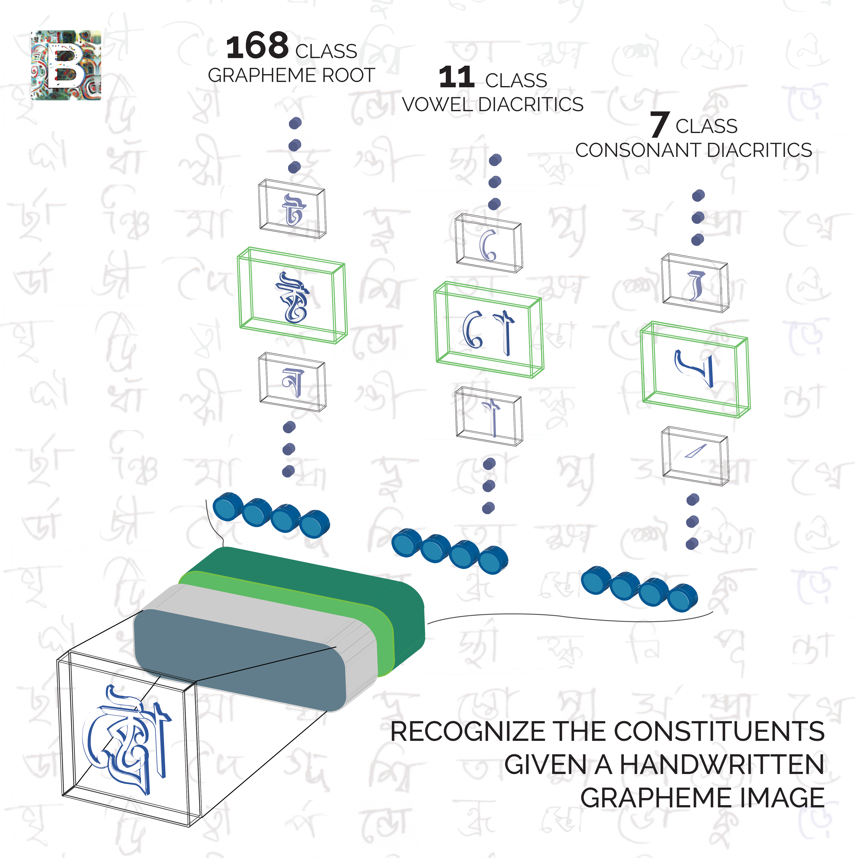
Methodology
Working Principle of the Recognition Model
To handle the complexities of the Bangla alphabets, we have divided them into three labels.
Grapheme Root
Vowel Diacritic
Consonant Diacritic

Slide 27
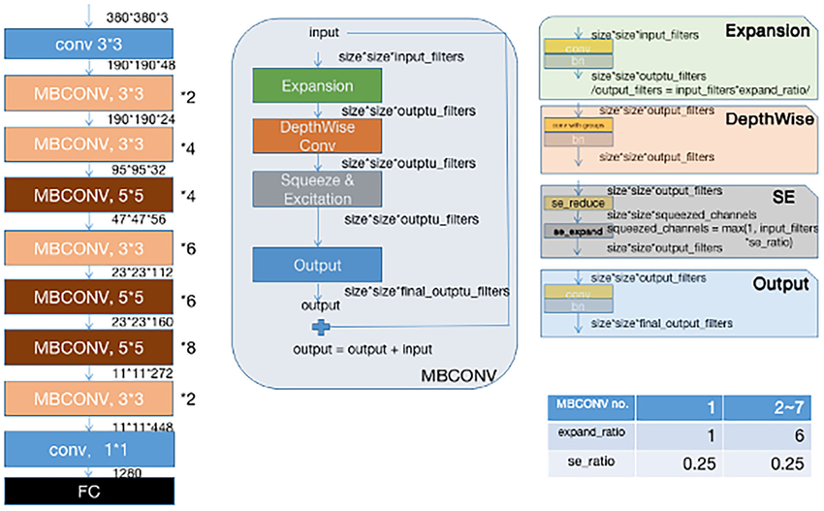
Methodology
Architecture of EfficientNet-b4 model

Slide 28
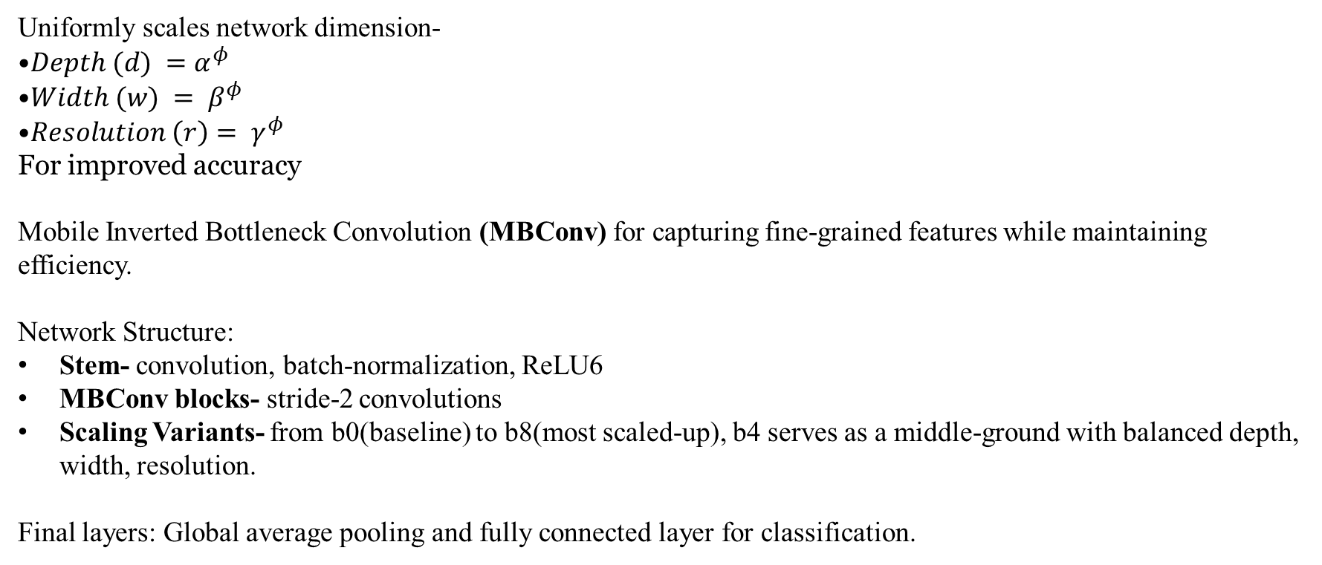
Methodology
Recognition using EfficientNet-b4 model
Uniformly scales network dimension-
$Depth (d) =$ $α^{φ}$
$Width (w) = β^{φ}$
$Resolution \left(r\right)= γ^{φ}$
For improved accuracy
Mobile Inverted Bottleneck Convolution (MBConv) for capturing fine-grained features while maintaining efficiency.
Network Structure:
Stem- convolution, batch-normalization, ReLU6
MBConv blocks- stride-2 convolutions
Scaling Variants- from b0(baseline) to b8(most scaled-up), b4 serves as a middle-ground with balanced depth, width, resolution.
Final layers: Global average pooling and fully connected layer for classification.

Slide 29
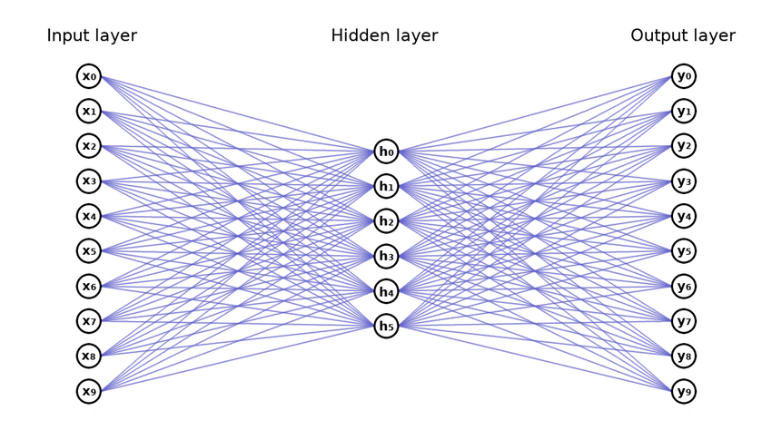
Methodology
Architecture of Word2Vec model

Slide 30
Methodology
Architecture of Word2Vec model
Main two architectures:
CBOW: target-word prediction from context.
Skip-Gram: predicts context words from target.
Network Components:
Input layer- as a one-hot vector
Projection layer- map one-hot vector to dense vector
Output layer
Uses negative sampling or hierarchical softmax for training.

Slide 31
Outline of Presentation
Introduction
Acknowledgement and References
Literature Review
Data Pre-processing and Training
Results
Methodology
Conclusion

Slide 32
Data Pre-processing and Training
Image Dataset
Detection Model
Recognition Model
Dataset Preparation: Pre-process specifically for detection model; employ background-noise removal and enhancement techniques.
Annotation: Annotate character regions using Roboflow.
Partitioning and Formatting: Divide annotations and images into training, validation, and test datasets; ensure proper formatting for detection model.
Loading Images: Load from Parquet files containing grayscale images.
Enhancement and Inversion: Enhance image quality and invert colour for consistency.
Resizing: Resize images to 28x28 pixels.
Saving Images: Save with standardized naming convention.
Aggregation and Partitioning: Split into training, validation, and test sets.

Slide 33
Data Pre-processing and Training
Text Dataset
Data Cleaning
Exclude words with special characters (e.g., ‘\’, ‘-’, ‘“’, ‘,’)
Maintain consistency by filtering out unwanted characters
Data Augmentation
Add district names and people’s names to enhance the dataset
Increase comprehensiveness and range of inputs
Saving Processed Data
Serialize and save the cleaned and augmented word list in a pickle file format
Ensure efficient loading and use for training

Slide 34
Data Pre-processing and Training
Detection Model Training
Optimizer: AdamW, Learning Rate: 0.002, Momentum: 0.9.
Parameters: Batch size 16, 300 epochs, early stopping with 50 epochs patience.
1. Initial Training:
- Dataset: Synthetic word data.
- Purpose: learn to isolate base and compound characters from words.
2. Fine-Tuning:
- Dataset: Handwritten word images.
- Focus: Handwritten features, complex characters, unique writing styles.
3. Synthetic-Noise Augmentation:
- Purpose: Enhance robustness against real-world noise.
- Benefit: Improved detection in handwritten images.

Slide 35
Data Pre-processing and Training
Recognition Model Training
Hyperparameters
Batch Size
Varies between 64 and 128.
Learning Rate
Initially set to 0.01 with dynamic adjustment based on validation loss using ReduceLROnPlateau.
Optimizer
Consistently use Adam optimizer for gradient-based optimization.
Training Epochs
Typically range from 30 to 50, depending on model complexity and dataset size.

Slide 36
Data Pre-processing and Training
Recognition Model Training
Model Definition
Loading Pretrained Model
Load the EfficientNet model without pretrained weights and the final classification layer.
Feature Extraction
Use layers from the pretrained model, except for the classifier.
Add a dropout layer to prevent overfitting.
Output Layers
Add three fully connected layers for predicting:
Grapheme root
Vowel diacritic
Consonant diacritic

Slide 37
Data Pre-processing and Training
Recognition Model Training
Training Loop
Hyperparameters Setup
Set essential parameters like epochs, batch size, and learning rate.
Model Initialization
Instantiate the model and move it to the appropriate device (CPU or GPU).
Loss Function
Define a custom loss function loss_fc to compute the average CrossEntropy loss across three outputs:
loss1 for grapheme_root
loss2 for vowel_diacritic
loss3 for consonant_diacritic

Slide 38
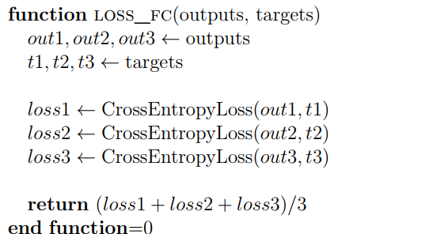
Data Pre-processing and Training
Recognition Model Training
Loss Calculations:

Slide 39
Data Pre-processing and Training
Spelling Correction Model
1. Training Configuration:
- Skip-gram algorithm with window size 4
- Vector size: 300 dimensions
- Minimum word count: 1
- 8 threads, 100 epochs
- Downsampling rate: 0.01
2. Checkpointing and Training:
- Trained on Bengali text corpus
- Checkpoints saved to ./checkpoints/
- Final model saved to results/
3. Exporting Weights:
- Extracts word vectors from trained model
- Saves embeddings to pretrained_weights.pickle in results/

Slide 40
Outline of Presentation
Introduction
Acknowledgement and References
Literature Review
Data Pre-processing and Training
Results
Methodology
Conclusion

Slide 41
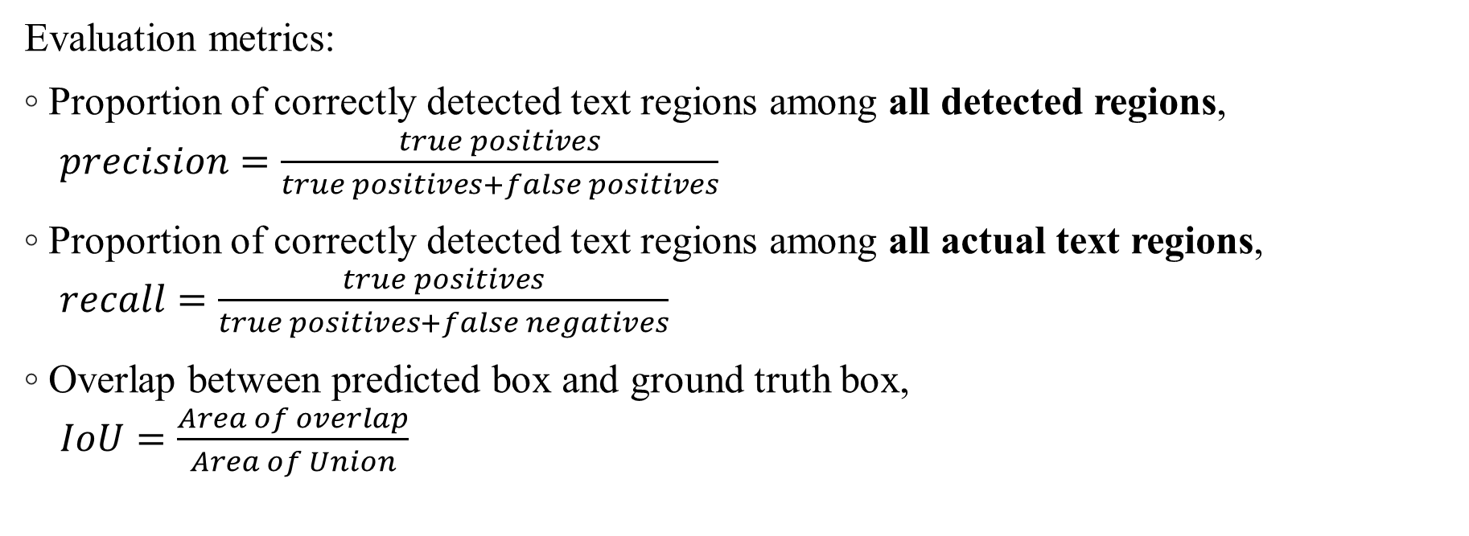
Results
For Detection Model:
Evaluation metrics:
Proportion of correctly detected text regions among all detected regions, $precision=\frac{true positives}{true positives+false positives}$
Proportion of correctly detected text regions among all actual text regions, $recall=\frac{true positives}{true positives+false negatives}$
Overlap between predicted box and ground truth box, $IoU=\frac{Area of overlap}{Area of Union}$

Slide 42
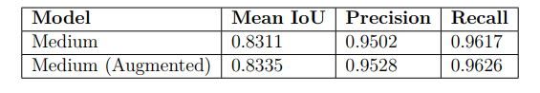
Results
For Detection Model:
Table-1: Performance of YOLOv8 trained variants without fine-tuning and tuning on handwritten data
Table-2: Comparison of best performing YOLOv8 variant fine-tuned on noiseless and noise augmented handwritten data

Slide 43
Results
Observations
Based on these observations, the YOLOv8 Medium model fine-tuned on augmented handwritten data emerges as the best-performing model for our OCR pipeline, balancing high metrics and robustness in text detection tasks.

Slide 44
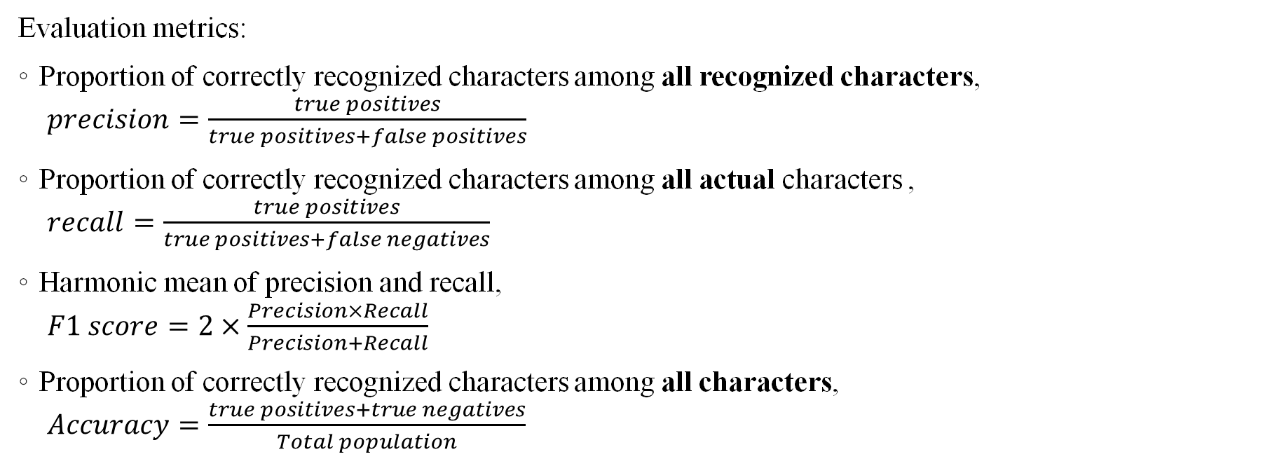
Results
For Recognition Model:
Evaluation metrics:
Proportion of correctly recognized characters among all recognized characters, $precision=\frac{true positives}{true positives+false positives}$
Proportion of correctly recognized characters among all actual characters , $recall=\frac{true positives}{true positives+false negatives}$
Harmonic mean of precision and recall, $F1 score=2×\frac{Precision×Recall}{Precision+Recall}$
Proportion of correctly recognized characters among all characters, $Accuracy=\frac{true positives+true negatives}{Total population}$

Slide 45
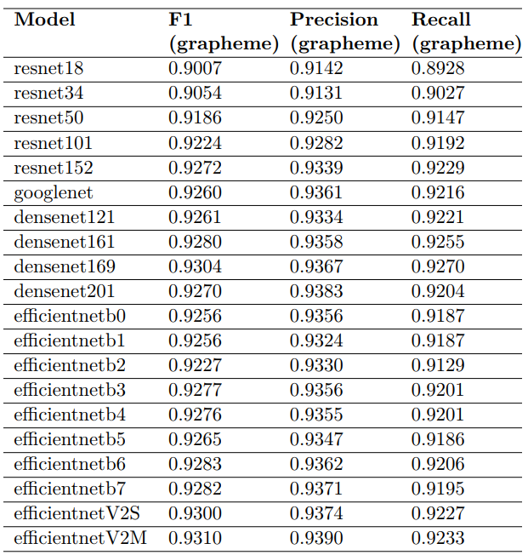
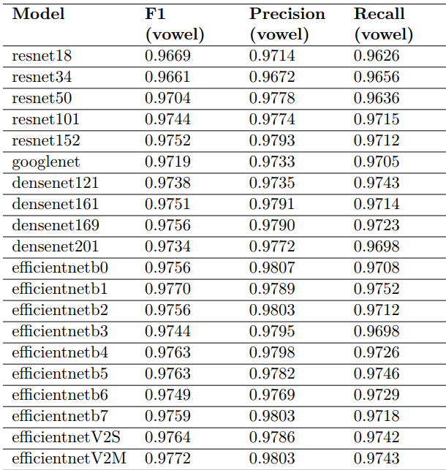
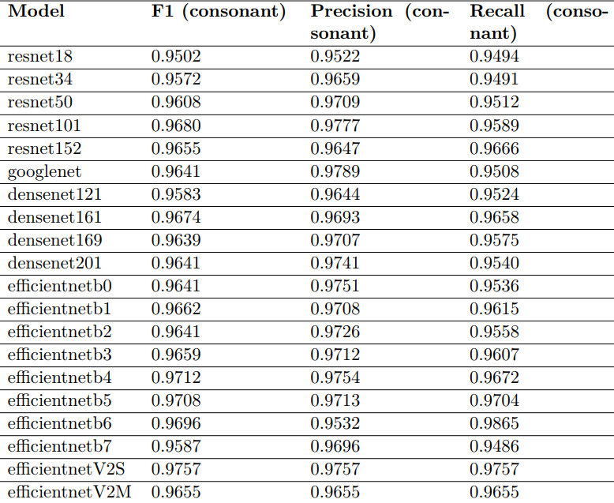
Results
Performance of different recognition model trained on isolated character images
Table1: Grapheme Root Metrics
Table2: Vowel Diacritic Metrics
Table3: Consonant Diacritic Metrics

Slide 46
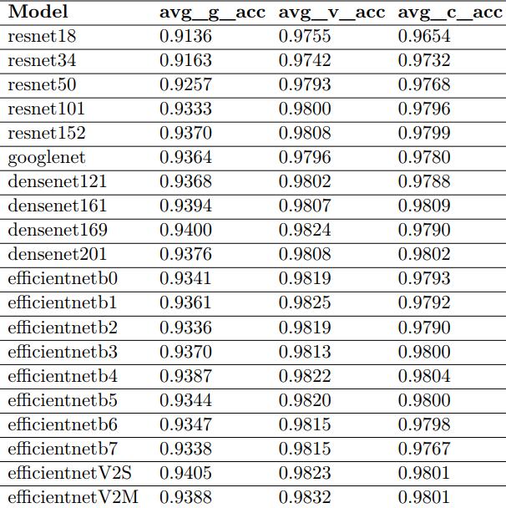
Results
Table: Accuracy Metrics Across the three labels

Slide 47
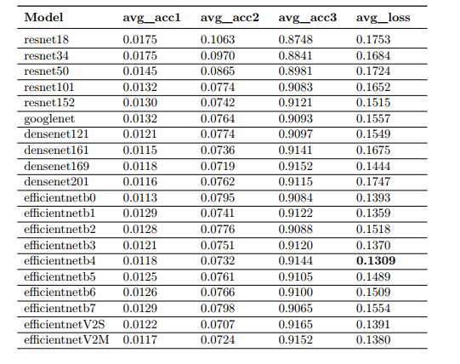
Results
Performance Analysis of Recognition Models
Table: Performance of different recognition model trained on isolated character images

Slide 48
Results
Performance Analysis of Recognition Models
Observation
ResNet models (e.g., ResNet50) show consistently high accuracy across all
components (grapheme, vowel, consonant).
DenseNet models (e.g., DenseNet161) achieve high accuracy but may require
more computational resources.
EffcientNet models (e.g., EffcientNetB4) offer a good balance between accuracy and loss.
All the models have similar accuracy scores but the EffcientNetB4 has the lowest average loss(0.131) for which we have chosen it to add to our pipeline

Slide 49
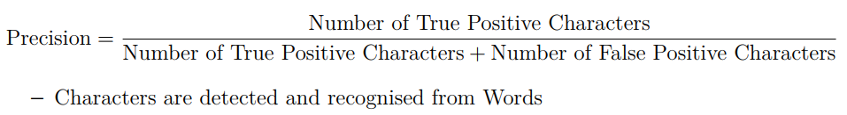
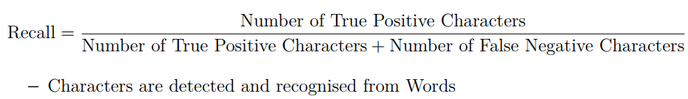
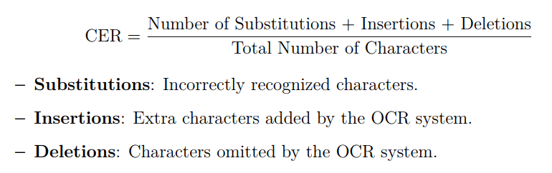
Results
Performance Analysis of Overall pipeline
Evaluation metrics:

Slide 50
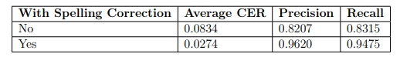
Results
Performance Analysis of Overall pipeline
Results:
Table: Performance of overall pipeline on handwritten words test data

Slide 51
Results
Performance Analysis of Overall pipeline
Observation:
• Benefits:
The system effectively increases accuracy while reducing loss, making it suitable for real-time applications. Significant improvements in CER and recognition metrics post-correction highlight the system’s reliability.
• Challenges:
Handling diverse handwriting styles and varying document quality remains a challenge. Further optimization may be required to reduce processing time and enhance real-time performance.

Slide 52
Outline of Presentation
Introduction
Acknowledgement and References
Literature Review
Data Pre-processing and Training
Results
Methodology
Conclusion

Slide 53
Conclusion
Future Works:
Enhancement of Dataset Diversity and Size
Improvement in Character Recognition Models
Robustness to Noise and Degradation
Integration with Multilingual OCR Systems
Enhanced Post-processing Techniques
Transitioning from Word to Paragraph-level OCR

Slide 54
Outline of Presentation
Introduction
Acknowledgement and References
Literature Review
Data Pre-processing and Training
Results
Methodology
Conclusion

Slide 55
Acknowledgement and References
We are deeply grateful to our supervisor, Dr. Mohammad Ariful Haque sir, for giving us the opportunity to work on this project and guiding us through the exploration of different techniques related to the project. We are thankful to our fellow supervise-es who we learned a lot of things from. Last but not the least, We are eternally indebted to our parents for encouraging us to take on newer challenges and providing us with never-ending support along the way.

Slide 56
Acknowledgement and References
Wahid, M.F., Shahriar, M.F. and Sobuj, M.S.I. “A classical approach to handcrafted feature extraction techniques for bangla handwritten digit recognition.” In “2021 International Conference on Electronics, Communications and Information Technology (ICECIT),” pp. 1–4, 2021
Alom, M.Z., Sidike, P., Hasan, M., Taha, T.M. and Asari, V.K. “Handwritten bangla character recognition using the state-of-art deep convolutional neural networks.”, 2018
Mahmud, F. (2017). A Complete Bangla OCR System for Printed Chracters. www.academia.edu. https://www.academia.edu/31726098/A_Complete_Bangla_OCR_System_for_Printed_Chracters
Ahmed, Shamim & M.A, Kashem. (2013). Enhancing the Character Segmentation Accuracy of Bangla OCR using BPNN. International Journal of Science and Research (IJSR). 2. 157-161.
Hasnat, Md & Habib, Murtoza & Khan, Mumit. (2010). Segmentation free Bangla OCR using HMM: Training and Recognition.
Sabir, E., Rawls, S., & Natarajan, P. (2018). Implicit Language Model in LSTM for OCR. Information Sciences Institute.

Slide 57
Acknowledgement and References
Biswas, M., Islam, R., Shom, G.K., Shopon, M., Mohammed, N., Momen, S. and Abedin, A. “Banglalekha-isolated: A multi-purpose comprehensive dataset of handwritten bangla isolated characters.” Data in Brief, volume 12:pp. 103–107, 2017
Rabby, A.S.A., Haque, S., Islam, M.S., Abujar, S. and Hossain, S. Ekush: A Multipurpose and Multitype Comprehensive Database for Online Off-Line Bangla Handwritten Characters, pp. 149–158, 07 2019
Roy, K., Hossain, M.S., Saha, P., Rohan, S., Rahman, F., Ashrafi, I., Rezwan, I.M., Hossain, B.M.M., Kabir, A. and Mohammed, N. “Synthetic Printed Words and Test Protocols Data for Bangla OCR.”, 6 2022
Addison Howard, Ahmed Imtiaz Humayun A.C.R.H.S.T. “Bengali.ai handwritten grapheme classification.”, 2019
Alam, S., Reasat, T., Sushmit, A.S., Siddique, S.M., Rahman, F., Hasan, M. and Humayun, A.I. “A large multi-target dataset of common bengali handwritten graphemes.” In “International Conference on Document Analysis and Recognition,” pp. 383–398. Springer, 2021
Kamal, M. “Bengali dictionary.” https://github.com/MinhasKamal/BengaliDictionary, 2024. GitHub repository
Chowdhury, A., HOSSEN, M.A. and Barua, A. “BDDB64.′′, 2023
Faruk, M. “Bengali names vs gender dataset.” https://huggingface.co/ datasets/faruk/bengali-names-vs-gender, 2024. Accessed: 2024-06-22

Slide 58
Acknowledgement and References
“Toward accurate fused deposition modeling 3d printer fault detection using improved yolov8 with hyperparameter optimization - scientific figure on researchgate.” https://www.researchgate.net/figure/The-improved-YOLOv8-network-architecture-includes-an-additional-module-for-the-he fig2_372207753. Accessed: 2024-06-21
A Deep Learning Based Framework for Diagnosing Multiple Skin Diseases in a Clinical Environment - Scientific Figure on ResearchGate. Available from: https://www.researchgate.net/figure/Original-efficientnet-b4-architecture_fig1_350928633 [accessed 23 Jun, 2024]
“Word2vec architecture.” ResearchGate, 2024. Accessed: 21 Jun, 2024

Slide 59
EEE 400: Bangla Handwritten OCR: A Hybrid Deep Learning Approach
Thank you

